Slide 1
Sequence Diagram

Slide 2
Introduction to Sequence diagram
Sequence diagram is interaction diagram that shows the set of objects and messages send and receive by those object.
It mainly emphases on time ordering and messages.
It is used to illustrate the dynamic view of system.

Slide 3
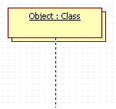
Terms and Concepts
Objects or Participants :-
The sequence diagram is made up of collection of participants or objects.
Participants are system parts that interact each other during sequence diagram.
The participants interact with each other by sending and receiving message
The object is represented by as below:

Slide 4
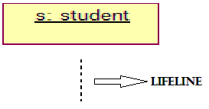
Terms and Concepts
Lifeline:-
Lifeline represents the existence of an object over a period of time.
It is represented by vertical dashed line.
Most objects that appeared in ‘Interaction diagram’ will be in existence for the duration of an interaction. So, these objects are aligned at top at top of diagram with their lifeline from top to bottom of diagram.

Slide 5
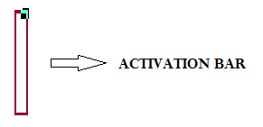
Terms and Concepts
Activation bar:-
It is also called as focus of control.
It shows the period of time during which an object is performing an action.
It is represented by tall thin rectangle:

Slide 6

Terms and Concepts
Messages:-
The interaction in a sequence diagram between the objects can be shown by using messages.
The messages on sequence diagram are specifies using an arrow from participant that wants to pass the messages to the participant that receive the messages .
Messages can be flow in whatever direction required for interaction from left to right and right to left.

Slide 7
Terms and Concepts
Messages:-
It has following kinds of messages:
1)Synchronous messages:-
* It is a message where the sender is blocked and waits until the receiver has finished processing of message.

Slide 8
Synchronous Call

Slide 9
Terms and Concepts
Messages:-
2)Asynchronous messages:-
* It is a messages where the sender is not blocked and can
continue executing.
* It is represent by solid line with half arrow.

Slide 10
Asynchronous Call

Slide 11


Terms and Concepts
Messages:-
It has following kinds of messages:
3)Reflexive messages:-
* If the object sends the message to itself then it is called as ‘Reflexive message.
* It is represented by solid line with loops the lifeline of object.
4)Return messages:-
* It can be used at the end of activation bar to show that control flow of activation returns to the participant that pass the original message.
* It is represent by dashed line from sender to receiver.

Slide 13
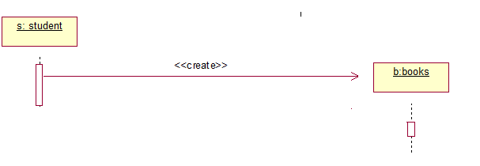
Terms and Concepts
Messages:-
It has following kinds of messages:
5)Create messages:- * It is used to create object during interaction.
* The object can be created by using <<create>> to indicate the timing of creation.

Slide 15
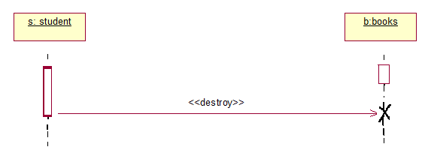
Terms and Concepts
Messages:-
6)Destroy messages:-
* It is used to destroy the objects during interaction.
* The objects can be terminated using <<destroy>> which points to an “x”.
* It indicates that object named message is terminated.

Slide 17
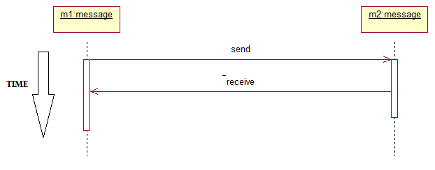
Terms and Concepts
Time:-
The sequence diagram describes the order in which interaction takes place.
Time is all about ordering but not duration.

Slide 18
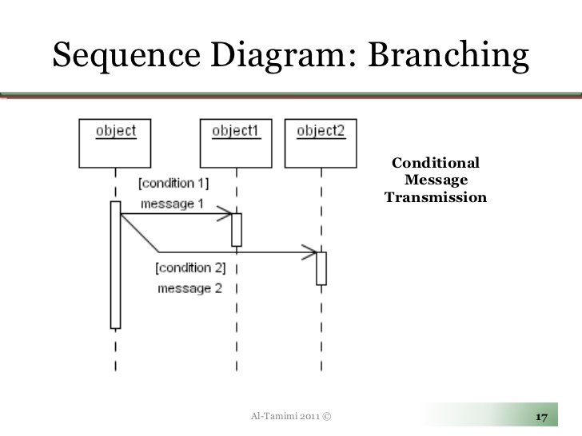

Slide 19
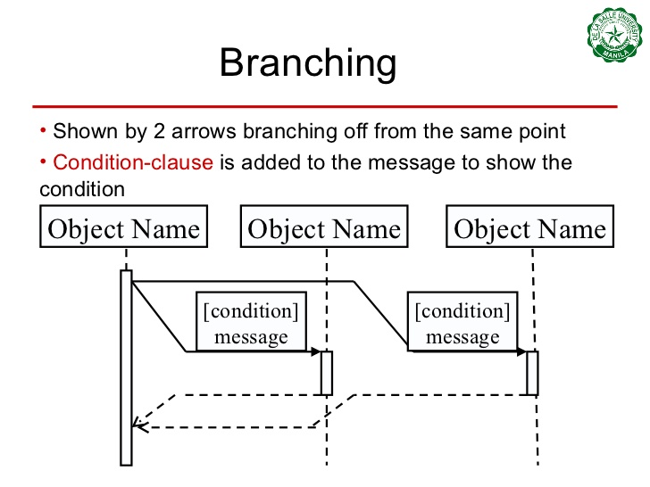

Slide 20
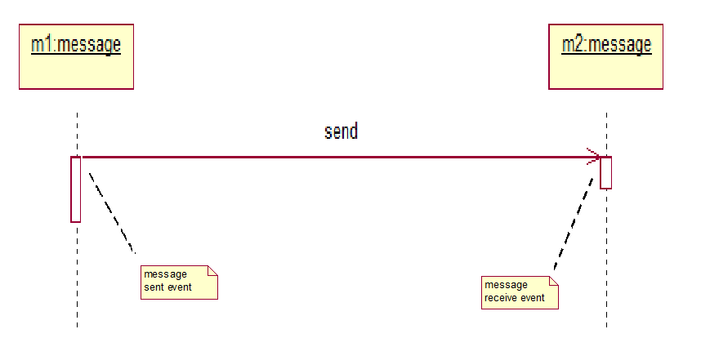
Terms and Concepts
Event:-
When interaction take place, Events are called as build in blocks for messages and signals.
Event is created while sending and receiving message.

Slide 21
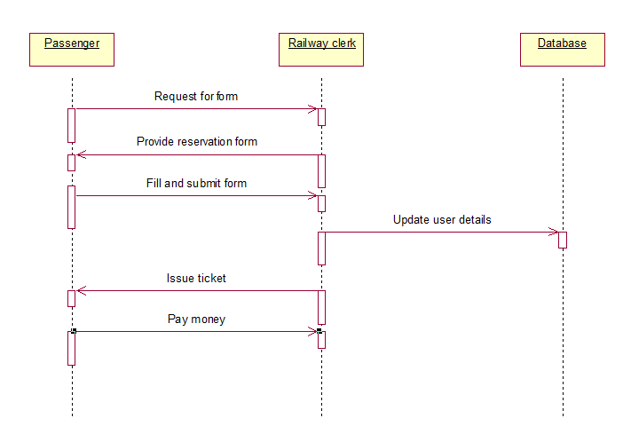
Sequence diagram of Railway reservation system

Slide 23
Order booking scenario

